Slide 1

MoM Generator
Lego Coders
Team:
Mayuri Mundada Vibha Chawla Shivam Mishra Parth Nagar
Sougata Karan

Slide 2

Agenda
Problem Statement & Solutions
Automation Overview
Features and Benefits
Demonstration
Future Enhancement
Q&A
Conclusion
1
1
2
3
4
5
6
7

Slide 3








Problem Statement & Solutions
Evernote
FreJun
Magic Minutes
workplace
Fathom
Grain
Colibri
Manual Intervention MoM
Access Limitation
Actions & Follow-ups
Ineffectual Efforts
Challenges
Automated MoM
In-house Application
Seamless Use
Real Time Transcript
Solutions

Slide 4



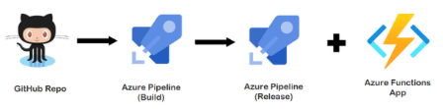
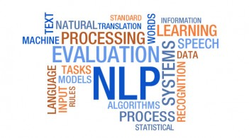

Automation Overview
Real Time Data Transcripts
MoM Conversion and Summarization
Email Notification to Intended Users
Speech Recognition
Text Conversion
Text summarization
Notify Audience
AZURE

Slide 5
Features and Benefits
Features
Transcribes speech in real time of all meeting participants
Real-time action items and feedback captured
Standard MoM template containing meeting time, participant names, discussion summary, queries & action items
User friendly UI
Download and trigger email notification to intended users
Seamless meeting minutes access to all team members
Benefits
Real-time recognition, summarization and visualization capabilities
Seamless meeting process
Improve meeting participants productivity
Scalable to integrate with other applications such as Teams, Rocket chat, Skype

Slide 6
Demonstration
Create JIRA entries based on Action item

Slide 7
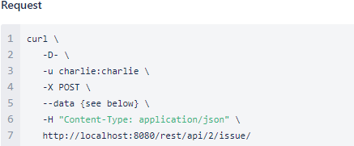
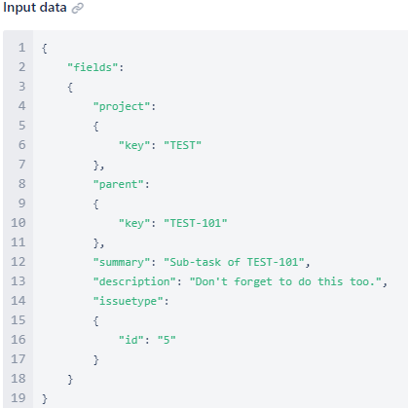
Future Enhancement
Integrate with Rocket Chat , MS Teams channel, Skype
Creating a sub-task
Transcript Settings Enablement
Transcripts APIs
Create JIRA entries based on Action item
JIRA REST APIs

Slide 8

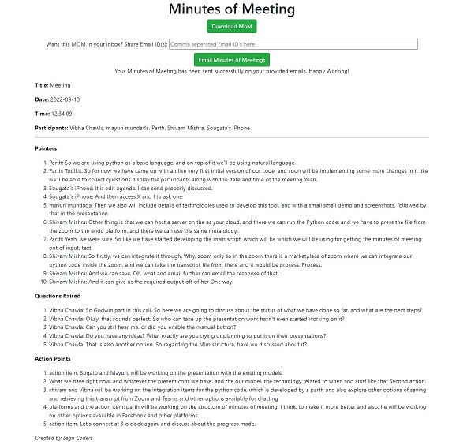
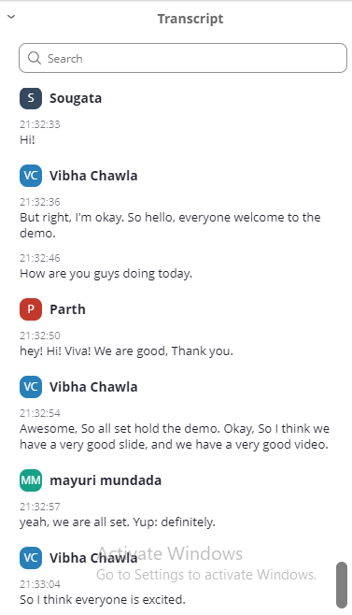
Conclusion
Real-time recognition, summarization and visualization capabilities
FEED ME YOUR TRANSCRIPT!
SUBMIT

Slide 9
Thank You
Any Questions ?

